Slide 1
Borrow
The word is borrow
What is the word?

Slide 2
borrow (verb)
To ask to use for a short time and return. Harry will ______ money form his sister and pay her back later.

Slide 3
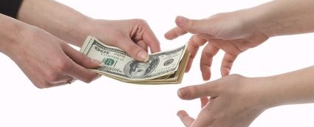
bor-row
verb

Slide 4
borrow
Jackson wanted to _____ Joe’s pencil for the assessment.
In order to complete the task I need to _______ a laptop.

Slide 5

borrow
Create your own sentence showing meaning

Slide 6
Check out
The word is check out
What is the word?

Slide 7
check out (verb)
To take a loan form the library. I will _______ 2 books from the library today.

Slide 8
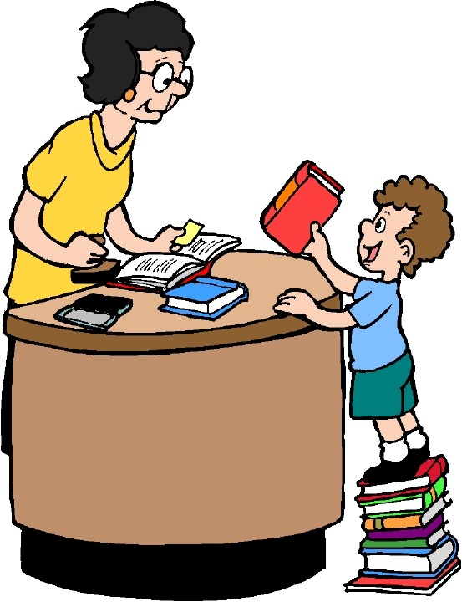
Check-out
verb

Slide 9
check out
Johnny will borrow library books therefore he will check out them.
The woman who works at the front desk will help check out the science tools from the office

Slide 10
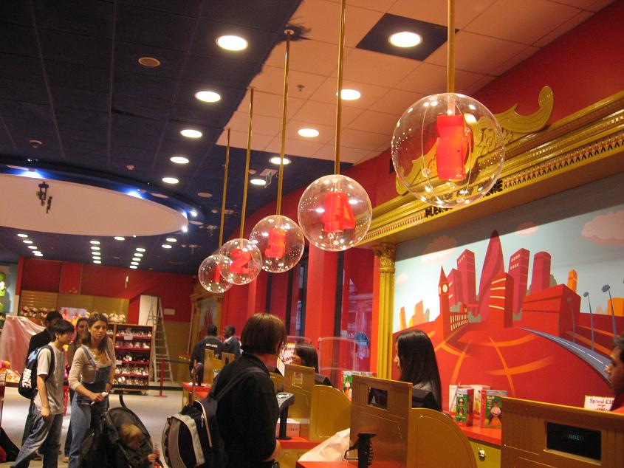
Check out
Create your own sentence showing meaning

Slide 11
eager
The word is eager
What is the word?

Slide 12
Eager (adj)
Feeling a strong desire. If you look forward to ski season you are ____ for it.

Slide 13
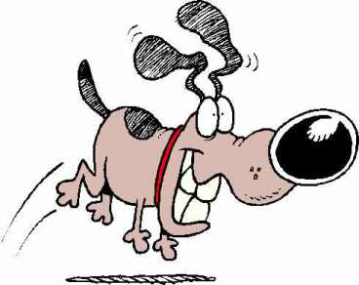
Eag-er
adjective

Slide 14
eager
The boy really couldn't’t wait for his birthday, he was eager for the day to arrive.
The dog sat inside all day she was eager to go on a walk.

Slide 15
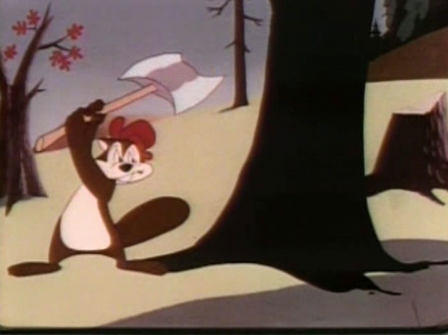
eag-er
Create your own sentence showing meaning

Slide 16
glaring
The word is glaring
What is the word?

Slide 17
glaring (verb)
Staring in an angry way. The principal was frustrated so he was ______ at the girls throwing food at lunch

Slide 18
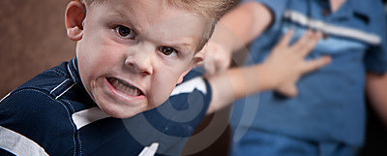
glar-ing
adjective

Slide 19
glaring
The sister was angry at her brother so she was glaring at him to claim his attention.
My mother was glaring at me when I spilled the paint all over her new carpet!

Slide 20
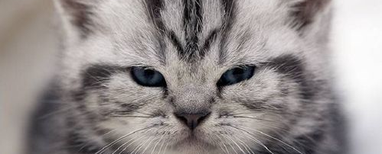
glar-ing
Create your own sentence showing meaning

Slide 21
lap
The word is lap
What is the word?

Slide 22
lap (noun)
The front part of the body from the waist to the knees when sitting. I placed the kitty in my ______ while sitting down. .

Slide 23
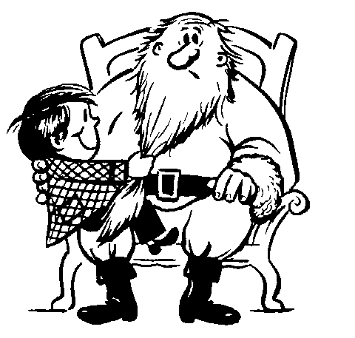
lap
noun

Slide 24
lap
Santa asked for me to sit on his lap so I could tell him what I wanted in my stocking.
When jack sat down his spilled milk on himself. It was in his lap.

Slide 25

lap
Create your own sentence showing meaning

Slide 26
storyteller
The word is storyteller
What is the word?

Slide 27
storyteller (noun)
A person who tells a story. In the library Ms. Kabish tells stories therefore she is a ______.

Slide 28
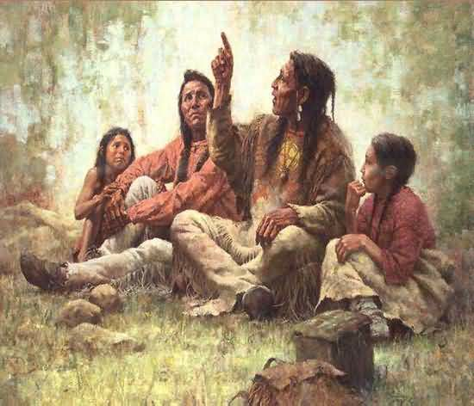
Stor-y tell-er
noun

Slide 29
storyteller
My grandfather told many stories therefore he was a storyteller.
The person who passes down stories from one generation to the next is a storyteller.

Slide 30
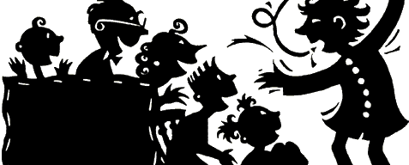
storyteller
Create your own sentence showing meaning

